Slide 1

Tiresias & Gandiva
GPU Cluster Manager
for Distributed Deep Learning
EECS 598
By Juncheng Gu
Notes:
Tiresias /taɪˈriːsiəs/

Slide 2


GPU Cluster for Deep Learning Training
Deep learning (DL) is popular
10.5× increase of DL training jobs in Microsoft
DL training jobs require GPU
Distributed deep learning (DDL) training with multiple GPUs
GPU cluster for DL training
5× increase of GPU cluster scale in Microsoft _{[1]}
Google Lens
Siri
How to efficiently manage a GPU cluster for DL training jobs?
[1]. Analysis of Large-Scale Multi-Tenant GPU Clusters for DNN Training Workloads. https://arxiv.org/abs/1901.05758
Notes:
DL tech has been widely applied in many domains, such as OD, speed recognition
With the increase of those applications, more and more DL models need to be trained.
In MS, the amount of DL training jobs has increased by more than 10 times.
Normally, those jobs are computing intensive, and require GPU hardware to execute.
Moreover, In distributed training, a single job can use multiple GPUs for better performance.
With the increasing demands of GPU resource, many companies have built their own GPU cluster for internal use
For example, In MS, the scale of it GPU clusters has been increased by 5x.
How to design a GPU cluster manager, which can efficiently manage GPU resource in the cluster for DL training jobs?

Slide 3
Tiresias
Information-agnostic
GPU cluster manager for Distributed Deep Learning
Schedule DL training jobs with unpredictable execution time
Place jobs with relaxed consolidation scheme

Slide 4
GPU Cluster Manager
Job Queue
Scheduler
Design Objectives
2
4
1
2
Placement Scheme
1
Minimize
Cluster-Wide Average
Job Completion Time (JCT)
1
N
N-GPU DL job
Free GPU
Achieve
High Resource (GPU) Utilization
Occupied GPU
4-GPU machine
GPU Cluster
Notes:
Let’s firstly see how a GPU cluster manager looks like
Assuming we have a GPU cluster, multiple GPUs are available in a single machine
Users submit their jobs to the cluster manager in an on-line fashion.
The resource requirement (GPU) of each job is specified by the users when submitting
The job scheduler inside the CM determines the execution order of those submitted jobs.
Once a job is scheduled, the placement scheme will allocate the required resources from the cluster and place the job for execution
A CM should be designed with the purpose of mini overall JCT. Meanwhile, it should be able to achieve High Res/GPU utilization.
However, DL training jobs have some unique challnges, which make it difficult for the CM to reach those targets

Slide 5

Challenge Ⅰ: Unpredictable Training Time
Unknown execution time of DL training jobs
Job execution time is useful when minimizing JCT
Predict job execution time
Use the smooth loss curve of DL training jobs (Optimus _{[1]})
1.0
⎯ DSSM
⎯ ResNext
⎯ Seq2Seq
1.0
It’s hard to predict training time of DL jobs in many cases
0.5
0.5
Norm. Train. Loss
Norm. Train. Loss
⎯ Job₁
⎯ Job₂
0.0
0.0
Progress
Progress
[1]. Optimus: An Efficient Dynamic Resource Scheduler for Deep Learning Clusters, EuroSys’18
Notes:
Firstly, the training time of DL jobs is unpredictable
As we all know, the execution time of a DL traiing job is often unknown before its completion.
However, the infor. Of jobs’ execution time is very useful when job scheduler is trying to mini JCT.
Therefore, people are trying to predict
Fortunately, for those well-defined DL models, they have smooth loss curve which is easy to learn.
Using this feature, we can estimate the remaining execution time of the training jobs, and this information in job scheduling.
However this method is not always valid in real cases.
DL models are explored in a trial-and-error manner. Many jobs are trials. Their models can have errors and bad configurations.
Because of these, their loss curve are non-smooth and unable to learn
Moreover, Because of the same reason, many jobs can be killed by their users at early stage. Only a small portion of jobs can run to completion.
Therefore, for DL jobs, it’s hard (if not possible) predict its training time in many cases.
Deep Semantic Similarity Model (DSSM)

Slide 6
Challenge ⅠⅠ: Over-Aggressive Job Consolidation
Network overhead in DDL training
Consolidated placement for good training performance
Fragmented free GPUs in the cluster
Longer queuing delay
4
4
N
N-GPU Job
Job Queue
Free GPU
Occupied GPU
Machine 2
Machine 1
Machine 2
Machine 2
Machine 3
Machine 4
Notes:
The second challenges is the over-aggressive job consolidation;
In D T, different job components need to exchange their intermediate results with each other. If they are distributed to different machines, then the data has to be transferred through the network, which may greatly slow down the training speed.
To protect the training performance, people will consolidate components onto the same machines or mini- number of servers. Which is called CP.
In this example, this 4-GPU job cannot be placed until there is a machine with 4 free GPUs availble.
Although, CD is proposed for good training performance. In fact, it can leave Frag GPUs under-utilized across the cluster, and jobs may suffer from longer queuing delay.

Slide 7
Prior Solutions
I. Unpredictable Training Time
(Scheduling)
II. Over-Aggressive Job Consolidation
(Job Placement)
Optimus_{[1]}
None
None
YARN-CS
FIFO
None
Gandiva_{[2]}
Time-sharing
Trial-and-error
[1]. Optimus: An Efficient Dynamic Resource Scheduler for Deep Learning Clusters, EuroSys’18
[2]. Gandiva: Introspective Cluster Scheduling for Deep Learning, OSDI’18
Notes:
To recap, in scheduling part, the execution time of DL training jobs is unpredictable; And in job placement, job compoents in distried training jobs are always consolidated;
The problem of Resource management for DL cluster has received lots of attentions. And several solutons have been proposed.
Optimus is a dynamic resource scheduler for DL Cluster. However, it relies on the smooth loss curve for job scheduling, and enforces consolidation when placing jobs.
YARN_CS which is currently used in a production cluster for DL training. Although, it doesn’t rely on the infor. of job exec time. Its FIFO-based scheduler perform poorly in optimizing JCT.
Gandiva is a most recent scheduling framework for DL jobs, where jobs are scheduled in time-sharing manner. However, T S is designed for fairness, not optimizing JCT. Instead of always enforcing job consolidation, Gandiva tries multiple different placements and pick the one with best training perform.
None of those systems can handle the two challenges very well.

Slide 8
Tiresias
A GPU cluster manager for Distributed Deep Learning Without Complete Knowledge
I. Age-Based Scheduler | Minimize JCT without complete knowledge of jobs
2. Model Profile-Based Placement | Place jobs without additional information from users
Notes:
Here, we propose our new solution: Tiresias,
Its age-based schedule can schedule jobs without complete knowledge of jobs
Also, it can make the placement decision based on the results from its model profiler.
Withour users’ input

Slide 9
Challenge I
How To Schedule DL Training Jobs
Without Complete Job Information?
Notes:
Let’s start from the scheduling, to see how T can schedule DL jobs without complete job information.

Slide 10
Temporal and Spatial Co-scheduling
Characteristics of DL Training Jobs
Variations in both temporal and spatial aspects
128
64
# of GPUs
Scheduler should consider both
temporal and spatial aspects of DL training jobs
32
Job execution time
16
Number of GPUs
8
4
2
1
10
10²
10³
10⁴
10⁵
Job execution time (min)
Notes:
To design the scheduler, we have to get a good understanding of DL training jobs.
We gathered job information from a 10-week trace in a production cluster, and found huge variations in both jobs’ temporal and spatial aspects.
This figure shows the distribution, in jobs’ execution time and GPU requirments, of those DL training jobs.
Each cycle maps to a specific combination of job execution time and GPU requirments. The area of the cycle represents the number of jobs in this group.
In temporal aspect, DL jobs can be executed for just several minutes to weeks. The same variation happens in jobs’ GPU requirement,.
Even for jobs with the same GPU req, there is still a huge variation in their execution time.
And vice versa.
Because of the those huge varations, the scheduler should consider both of the temporal and spatial aspects. Of jobs.

Slide 11
Available Job Information
Spatial: number of GPUs
Temporal: executed time
Executed time
G₃
G₂
# of GPUs
?
…
G₁
0
1
2
3
4
5
6
7
8
9
10
11
Time
Notes:
In the spatial aspect, jobs’ GPU reqirment is always given by the users
However, in temporal aspect, no one has the knowledge about how long this job is going to run/
But, once the job get executed, and If we look back in the timeline, the cluster manager can easily get its executed time.

Slide 12
Age-Based Schedulers
Least-Attained Service_{[1]} (LAS)
Prioritize job that has the shortest executed time
Gittins Index policy_{[2]}
Need the distribution of job execution time
Prioritize job that has the highest probability to complete in the near future
Age (executed time)
G₃
G₂
# of GPUs
?
…
G₁
# of GPUs
0
1
2
3
4
5
6
7
8
9
10
11
Time
[1]. Feedback queueing models for time-shared systems. JACM, 1968
[2]. Multi-armed bandit allocation indices. Wiley, Chichester, 1989
Notes:
Jobs’ exected time is often called job age.
There have been several classic Age-based schedulers proposed to minimize JCT.
1. LAS ( has been applied for flow scheduling in DCN
It prefers jobs with shorter executed time.
Jobs with longer executed time will have lower priority in LAS.
The idea of LAS has been widely applied in the flow control in the DCN,
2. G I
The same as LAS, jobs’ priority is determined by jobs’ age.
Howeve, GI need to know the distribution of jobs’ execution time.
With those information two kinds of information, the algorithm calculates the probability to complete of this job in the near future.
In order to minimize JCT, jobs with large GI have higher priorities to run.

Slide 13
Two-Dimensional Age-Based Scheduler (2DAS)
Age calculated by two-dimensional attained service
i.e., a job’s total executed GPU time (# of GPUs × executed time)
No prior information
2D-LAS
With partial information: distribution of job GPU time
2D-Gittins Index
Notes:
Based on those two classic age-based algorithms, we proposed a two-dimensional ab scheduler, which is called 2DAS
In this scheduler, jobs’ age is calculated by the two D attained service. In our problem, its’ job’s total executed GPU time.
2DAS can work with different available job informatin.
When there are no extra information available, we will use 2D-LAS for job scheduling. A job who receied more service will have lower priority.
If the cluster operator can provide the xxxx from previous experience, then 2D-G I will be applied;
Here, jobs’ GI is calculated based on jobs attained service. Higher GI means higher probability to complete , also maps to higher priority.
Next, let’s use a simple example to learn more details of 2D-G I.

Slide 14
2D-Gittins Index: Partial Information
Higher probability to complete (Gittins Index), higher priority
 | # of GPUs | Duration | Attained Service | Gittins Index
J₁ | 2 | 2 | 0 | 0.25
J₂ | 1 | 8 | 0 | 0.25
J₃ | 2 | 6 | 0 | 0.25
 | # of GPUs | Duration | Attained Service | Gittins Index
J₁ | 2 | 2 | 4 | 0.2
J₂ | 1 | 8 | 0 | 0.25
J₃ | 2 | 6 | 0 | 0.25
 | # of GPUs | Duration | Attained Service | Gittins Index
J₁ | 2 | 2 | 4 | 0.2
J₂ | 1 | 8 | 4 | 0.2
J₃ | 2 | 6 | 0 | 0.25
 | # of GPUs | Duration | Attained Service | Gittins Index
J₁ | 2 | 2 | 4 | 0.2
J₂ | 1 | 8 | 8 | 0.125
J₃ | 2 | 6 | 4 | 0.2
 | # of GPUs | Duration | Attained Service | Gittins Index
J₁ | 2 | 2 | 4 | 0.2
J₂ | 1 | 8 | 8 | 0.125
J₃ | 2 | 6 | 12 | N/A
 | # of GPUs | Duration | Attained Service | Gittins Index
J₁ | 2 | 2 | 4 | 0.2
J₂ | 1 | 8 | 4 | 0.2
J₃ | 2 | 6 | 4 | 0.2
Distribution
Execution time
(4, 8,12)
J₁ end
Job switch
Job switch
J₂ end
J₃ end
 | Extra Information | Avg. JCT
2D-Gittins Index | GPU time distribution | 10.0
2D-LAS | None | 11.7
G₂
G₁
0
1
2
3
4
5
6
7
8
9
10
11
12
13
14
15
16
Time
Notes:
Here, jobs’ GI is calculated based on jobs attained service. Higher GI means higher probability to complete , also maps to higher priority.
Assuming there are 3 DL training jobs to be scheduled. From the view of our scheduler, it has no knowledge of jobs’ execution time.
However, the distri of jobs’ GPU time is provided. Where jobs can have 3 different total GPU time.
The input of this algorithm is josb’ attained service.
This figure shows how jobs’ GI value changes with the increase of their attained service under this distribution
Different from 2D-LAS, where jobs’ priority will linearly decrease with the increase of attained ser.
At the beginning, when jobs’ attained server getting closer to a (GPU time in the distri), it will receive higher priority.
However, if it receives 4 unit of service without completion, it’s priority or GI will be much lower than before.
And this pattern will repeat when it’s getting closer to 8 GPU time.
At the beginning, no one has received any service, they have the same priority, we will schedule them following their orders in the job queue.
Now, we have two gpus available.
Firstly, Job 1 get executed, during its’ running, it always has the highest priority to run.
Next, job 2 starts. However, after receving 4 units of GPU time, job 2 hasn’t complete, then, its’ priority becomes lower than jobs3. There is a job switch from j2 to j3 at time 6.
The same situation happens after job3 received 4 unit of service.
In the end, the avg. JCT in this example is 10. If we apply 2D_LAS in this example, and its avg. jct is 11.7
With more job information provided, 2D G I performs better in minimizing JCT.
During the job scheduling, job switches can be triggered by the scheduler.
However, there is a large overhead when switching DL training jobs on GPU.

Slide 15
Two-Dimensional Age-Based Scheduler (2DAS)
Age calculated by two-dimensional attained service
i.e., a job’s total executed GPU time (# of GPUs × executed time)
No prior information
2D-LAS
With partial information: distribution of job GPU time
2D-Gittins Index
Fewer job switches
Priority discretization: Discretized-2DAS
Notes:
During the scheduling, there are job switches triggered by our scheduler. However, the time-overhead of switching DL jobs on GPU is non-negligible.
To reduce the number of job switches, we discretize jobs priorities in our scheduler.

Slide 16
Less Job Switches
Priority Discretization with Multi-level Feedback Queue_{[1]} (MLFQ)
Q₁
Highest-Priority
Queue
DL Job
Discretized-2DAS
2DAS within a queue
Priority across queues
A Job will be demoted when its attained service exceeds the queue threshold
Q₂
…
Q_{K}
Lowest-Priority
Queue
[1]. Scheduling: The multi-level feedback queue. Operating Systems: Three Easy Pieces

Slide 17
Prior Solutions
I. Unpredictable Training Time
(Scheduling)
II. Over-Aggressive Job Consolidation
(Job Placement)
Optimus_{[1]}
None
None
YARN-CS
FIFO
None
Gandiva_{[2]}
Time-sharing
Trial-and-error
Tiresias
LAS
Gittins Index
?
Discretized-2DAS
[1]. Optimus: An Efficient Dynamic Resource Scheduler for Deep Learning Clusters, EuroSys’18
[2]. Gandiva: Introspective Cluster Scheduling for Deep Learning, OSDI’18
Notes:
To handle the challenge of unpredictable training time from DL jobs,
We proposed our Discretized-2DAS scheduler.
It has has different scheduling schemes when different job information is available.
Next, I will briefly introduce how to place a DL job based on its model information

Slide 18
Challenge II
How to Place DL Jobs
Without Hurting Training Performance?
Notes:
Next, for the sake of time I will briefly introduce how T place DL jobs without hurting training performance.

Slide 19
Characteristics of DL Models
Tensor size in DL models
Large tensors cause network imbalance and contention
600
500
Consolidated placement is needed when the model is highly skewed in its tensor size
400
Size (MB)
300
200
100
0
VGG11
VGG16
VGG19
AlexNet
ResNet50
Inception3
ResNet101
ResNet152
Inception4
GoogleNet
Notes:
To answer that question, let’s look at the tensors size in DL models.
A DL model consists of many tensors.
This figure show the tensor size in 10 popular DL models.
In each bar, the color blocks are tensors in the model.
Larger block means large tensor in the model.
For the vgg models, and Alnext, they are highly-skewed in their tensor size distributions.
And the largest tensor takes the most space of its model.
In the rest 6 models, their tensor sizes are more evenly distributed.
The data transfer in distributed training is determined by tensors size in model.
When the job is not consolidated, Those large tensors can leads to the network imbalance and conteion Which can greatly slow down the training speed
Because of this reason, the consolidated placement is only needed when the model is highly skewed in its tensor size;
For other models who have evenly-distributed tensors, their performance is not sensitive to job consolidation

Slide 20
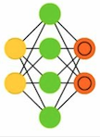
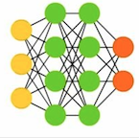
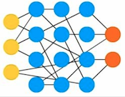
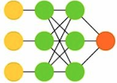
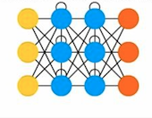
Model Profile-Based Placement
NO
Model Profiler
AlexNet
GoogleNet
Inception3
VGG19
Inception4
VGG11
Consolidation?
VGG16
ResNet101
ResNet152
ResNet50
YES
Notes:
Based on this observation, we propose a simple but useful solution.
In the placement part, we have a model profiler which can capture tensor size information.
If the tensors in the model is highly-skewed, then our system will consolidate the job.
Otherwise, the job will be assigned with available resource, which may come from different machines

Slide 21
Discretized-2DAS
Central Master
Placement scheme
DL Job
(model, resource)
Model profiler
Tiresias
Evaluation
Placement
Preemption
60-GPU
Testbed Experiment
Central Master
Network-Level Model Profiler
Large-scale &
Trace-driven Simulation
GPU Cluster
Notes:
We have built a prototype system for Tiresias. It has a cluster-wide central master who makes the scheduling and placement decisions.
On each machine in the cluster, there is a network-level model profiler to collect model information for placement scheme.
We have evaluated our system in both xxx and xxx

Slide 22
JCT Improvements in Testbed Experiment
Testbed – Michigan ConFlux cluster
15 machines (4 GPUs each)
100 Gbps RDMA network
Avg. JCT improvement (w.r.t. YARN-CS): 5.5×
Comparable performance to SRTF
10
10²
10³
10⁴
10⁵
21
Notes:
Our testbed has 15 servers, each has 4 GPUs. All servers are connected by a 100Gbps RDMA network.
This figure shows the JCT distribution with different cluster manager.
Our baseline is YARN-CS who schedule jobs in FIFO order.
We also implemented a SRTF scheduler and provide the information of job execution time from actual runs.
This blue line is our system. Comparing to YARN-CS, many jobs have much short queuing delay.
And the JCT is improved by more than 5 times.
Also, our system shows comparable performance to SRTF who has complete job information.

Slide 23
JCT Improvements in Trace-Driven Simulation
Discrete-time simulator
10-week job trace from Microsoft
2,000-GPU cluster
Avg. JCT improvement (w.r.t. Gandiva): 2×
10²
10³
10⁴
10⁵
10⁶
10⁷
Notes:
We run the simulation using the 10-week trace from MS.
This is the JCT distribution in this simulation.
Other than YARN-CS, and SRTF. We also compare our system with Gandiva which is one of the most recent scheduling framework for DL jobs.
With our system, almost all jobs can have shorter completion time. The ave. JCT is improved by 2 times over Gandiva.
More evaluation results can be found in our paper

Slide 24

Tiresias
A GPU cluster manager for Distributed Deep Learning Without Complete Knowledge
Optimize JCT with no or partial job information
Relax placement constraint without hurting training performance
Simple, practical, and with significant performance improvements
https://github.com/SymbioticLab/Tiresias
Notes:
To conclude, Tiresias is an efficient and information-agnostic xxxx
It can optimize xxxx and relax the placement
The design in Tiresias is simple, and prac, and has showed greate performance imrpovements comparing to existing solutions
30% are failed because of errors in

Slide 25
Q&A
Tiresias only considers GPU for training. But training can also be performed on CPU for cost-effective reasons. Thus, will the existing scheduler work well in this CPU-GPU heterogenous clusters.
Themis (NSDI’20) is a DLT scheduler for fairness, not avg. JCT. Which objective makes more sense (fairness, avg. JCT)?
Notes:
Consolidation: the minimum number of servers.

Slide 26
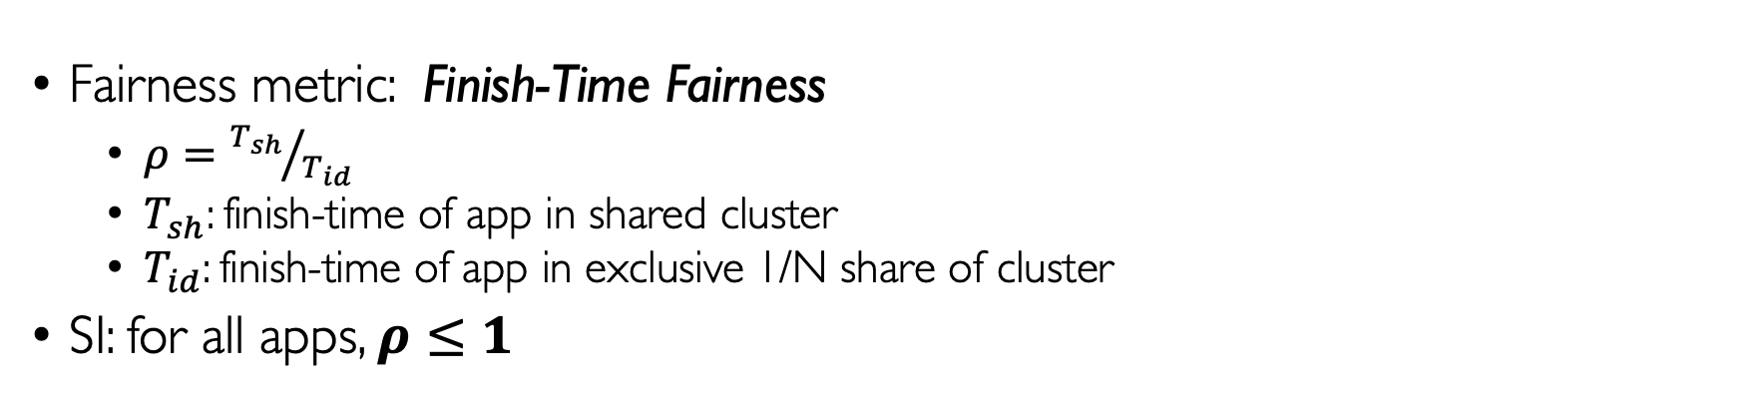
Themis: Fair and Efficient GPU Cluster Scheduling
How to fairly (efficiently) share a GPU cluster among multiple DL training jobs ?
Primary goal – sharing incentive (SI)
If N DL apps are sharing a cluster then no DL app should run shower than on a private cluster with 1/N resources
Shared Running time < independent running time
Fairness metric: Finish-Time Fairness
$ρ={T_{sh}}/{T_{id}}$
$T_{sh}$: finish-time of app in shared cluster
$T_{id}$: finish-time of app in exclusive 1/N share of cluster
SI: for all apps, $ρ≤1$
Notes:
Consolidation: the minimum number of servers.

Slide 27
Gandvia
Introspective GPU cluster scheduling for Deep Learning Training
Continuous and introspective scheduling to adapt to the changing environment
Faster & cheaper execution of DLT workflows

Slide 28
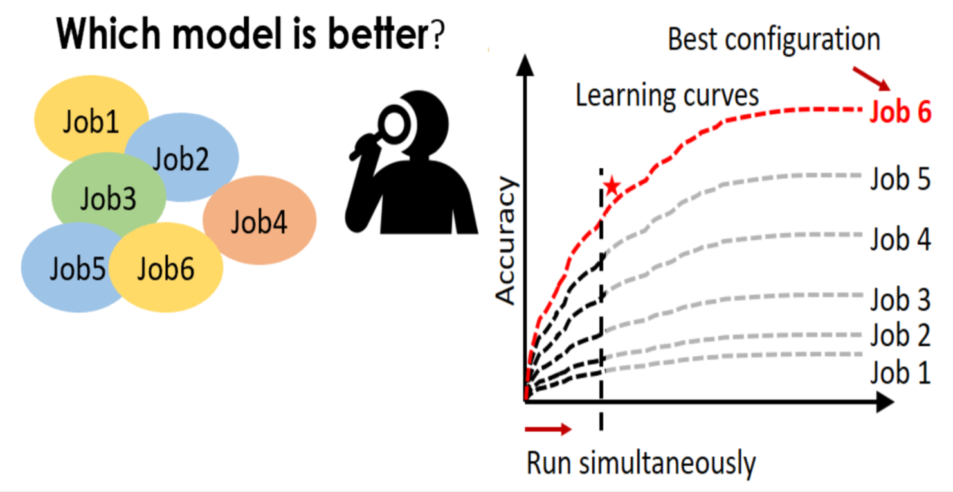
Characteristics of DLT
DLT is mostly trail-and-error (feedback-driven exploration)
Hyperparameter-tuning
A trail job can last for hours or days
Lots of trails => high cost
Notes:
HOL blocking

Slide 29
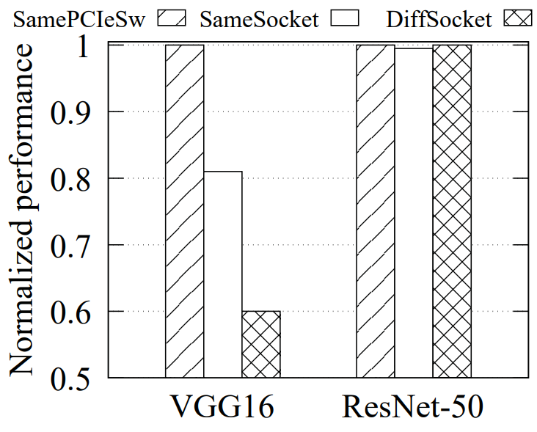
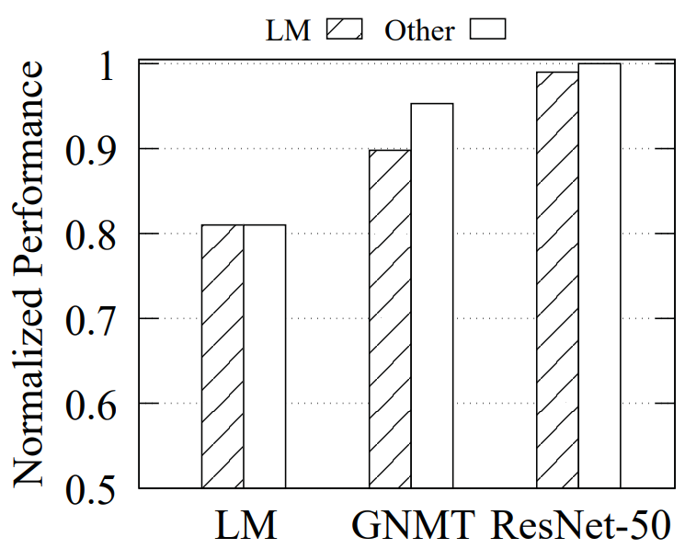
Characteristics of DLT
Sensitivity to locality and interference varies across jobs
DLT jobs are heterogenous in terms of memory usage, GPU core utilization, interconnect (PCI, NIC) bandwidth
Locality: GPU affinity (intra- & inter-server)
Notes:
HOL blocking

Slide 30
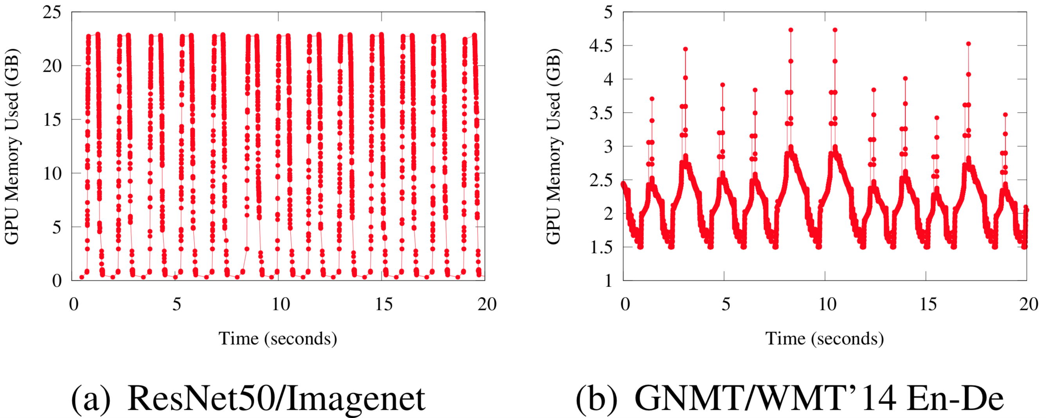
Characteristics of DLT
Intra-job predictability of DLT
A DLT job consists of numerous repetitive iterations
Iterations are identical mini-tasks
Resource usage
Execution time
Notes:
Low GPU memory utilization

Slide 31
Existing Scheduler
Treat DLT jobs as generic big-data jobs (e.g., use YARN, Kubernetes)
A job get exclusive access to GPU, and holds it until completion
Head-of-line blocking (when there are long DLT jobs)
High queuing delay (job completion time)
Fixed job-placement decision
Low efficiency
2-GPU Job
Server 1
Server 2
Notes:
Low GPU memory utilization

Slide 32
Gandvia
Introspective GPU cluster scheduling for Deep Learning Training
Partition DLT jobs into micro-tasks at their iteration boundary
Flexible scheduling primitives for DLT
Time slicing (suspend and resume), packing, migration, scaling (growth and shrink)
Continuous and introspective scheduling to adapt to the changing environment
Application-aware profiling

Slide 33
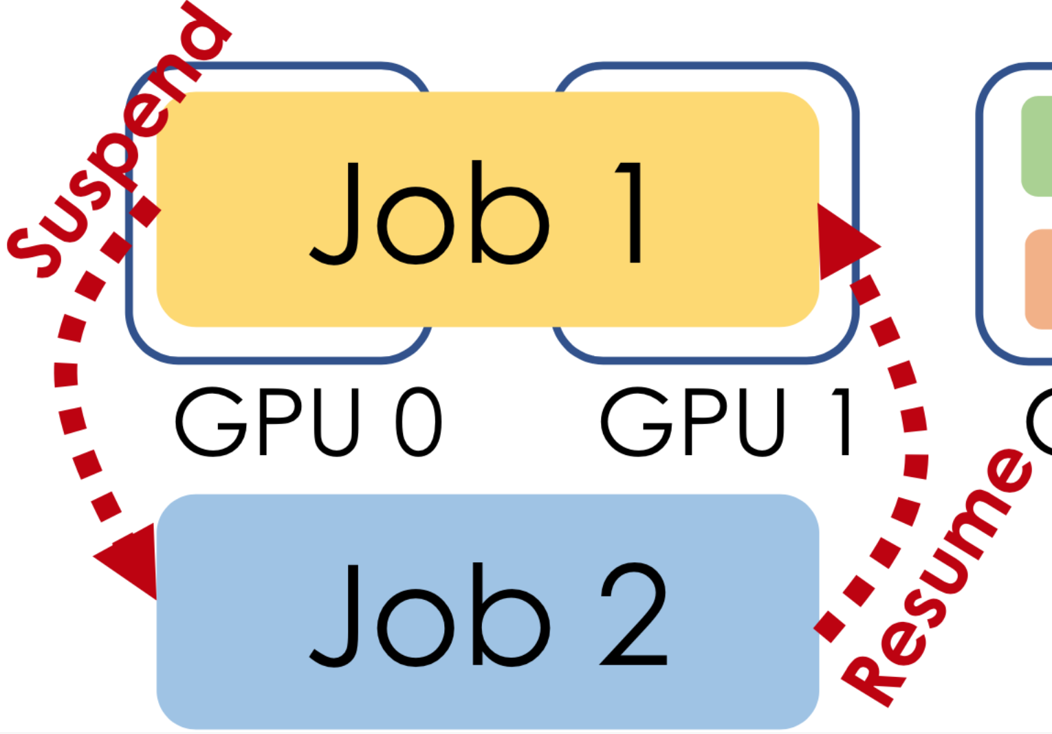
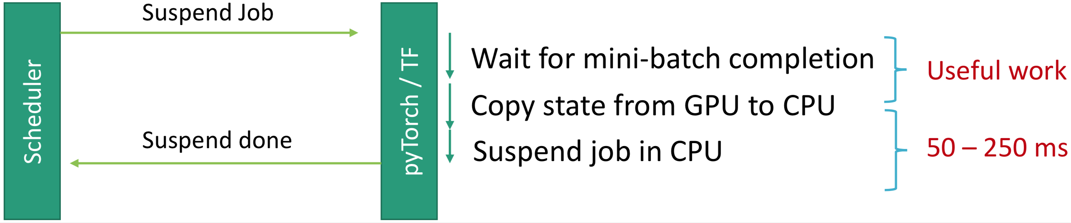
Time-slicing
GPU time-multiplexing when GPUs are over-subscribed
Faster multi-job execution during hyper-parameter searching
DLT job switch (suspend-resume) for every ~100 iterations
At iteration boundary
Notes:
Low GPU memory utilization

Slide 34
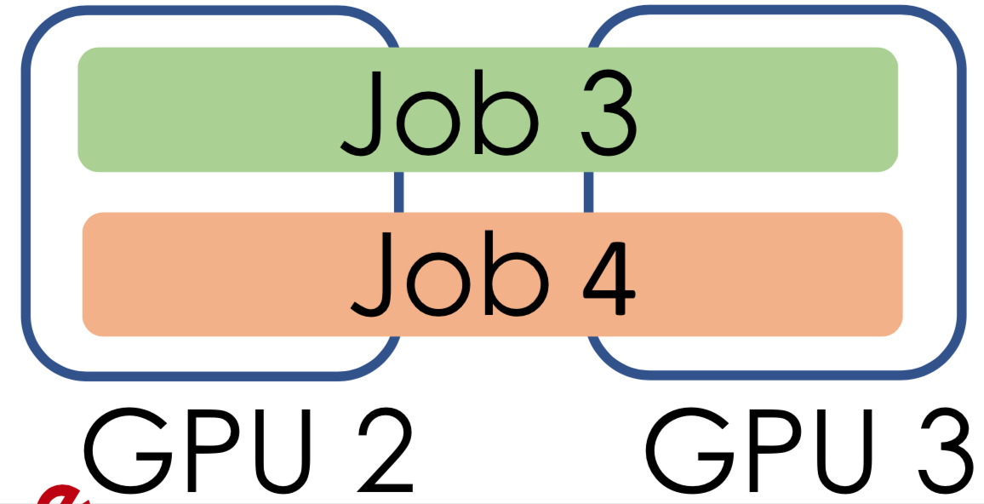
Packing
Pack multiple jobs onto the same GPU
The packed jobs do not exceed the GPU capacity, and do not impact each other
Notes:
Low GPU memory utilization

Slide 35
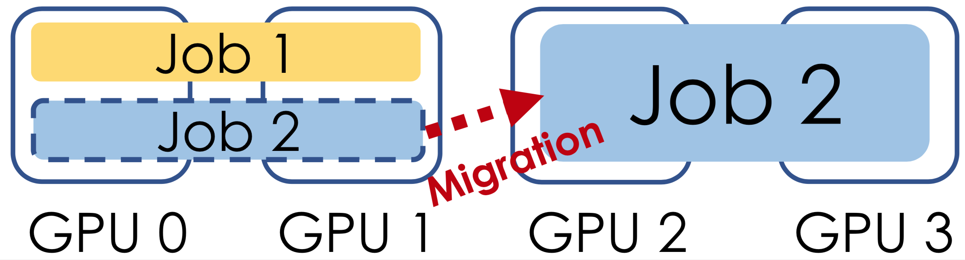
Migration
Move DLT jobs across GPUs to improve efficiency
Reduce job interferences
Cluster de-fragmentation
Integration with DL framework’s checkpoint and restore
<1s migration cost
Notes:
Low GPU memory utilization

Slide 36
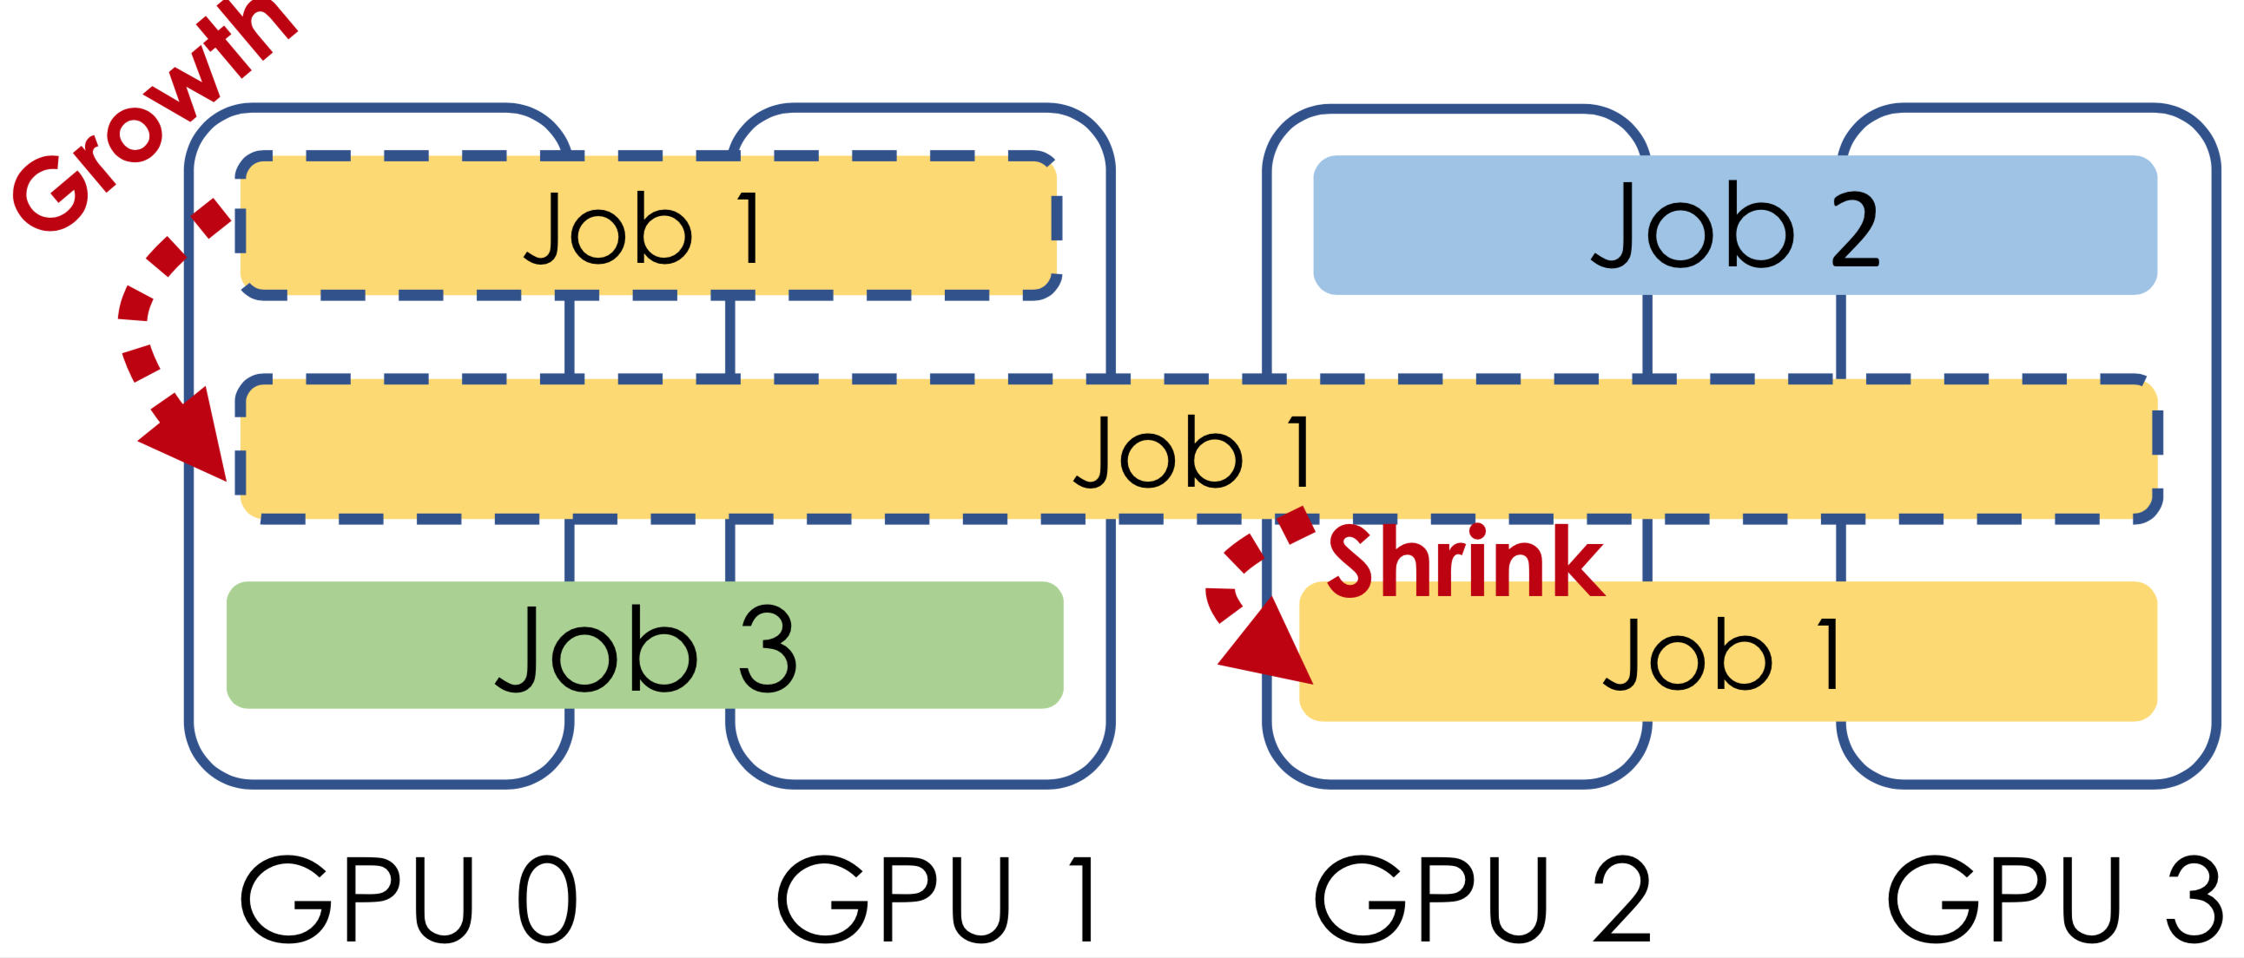
Scaling (growth-and-shrink)
Opportunistically grow the number of GPUs to a job during idle time
And shrink the number of GPUs when cluster load increases
Notes:
Low GPU memory utilization

Slide 37
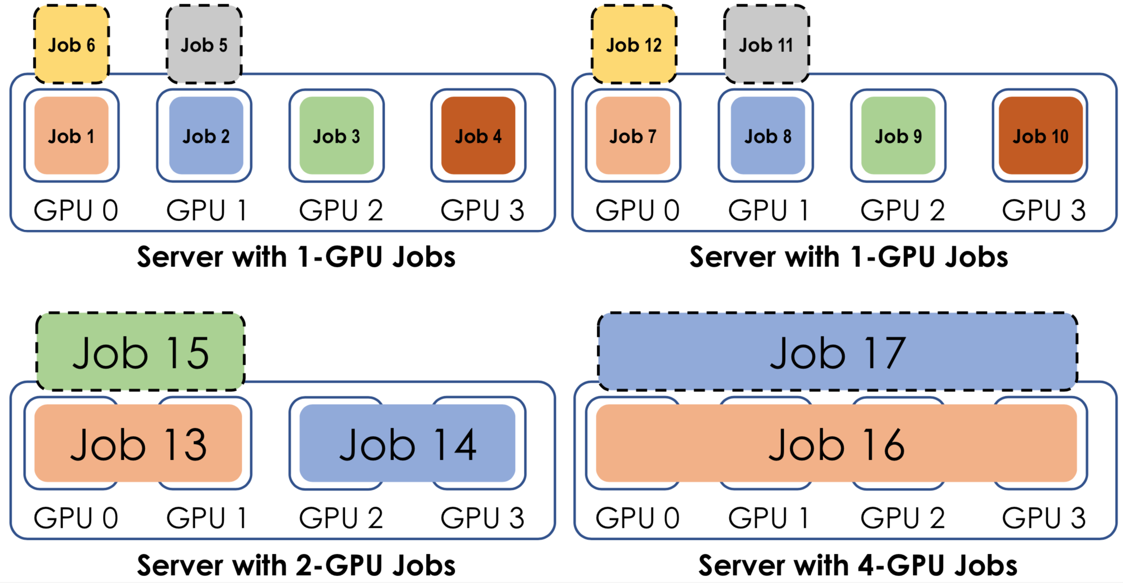
Job Scheduling – reactive mode
Handle job arrivals, departures, and machine failures (like traditional scheduler)
Bin-packing jobs with the same GPU requirements
Round-robin time sharing when GPUs are oversubscribed
Notes:
Low GPU memory utilization

Slide 38
Job Scheduling – introspective mode
Continuously monitor and optimize job placements to adapt to the changing environment
Try packing, migration, time-slicing
Measure benefit
Revert quickly if negative
Notes:
Low GPU memory utilization

Slide 39
Job Scheduling – introspective mode
Continuously monitor and optimize job placements to adapt to the changing environment
Try packing, migration, time-slicing
Measure benefit
Revert quickly if negative
Notes:
Low GPU memory utilization

Slide 40
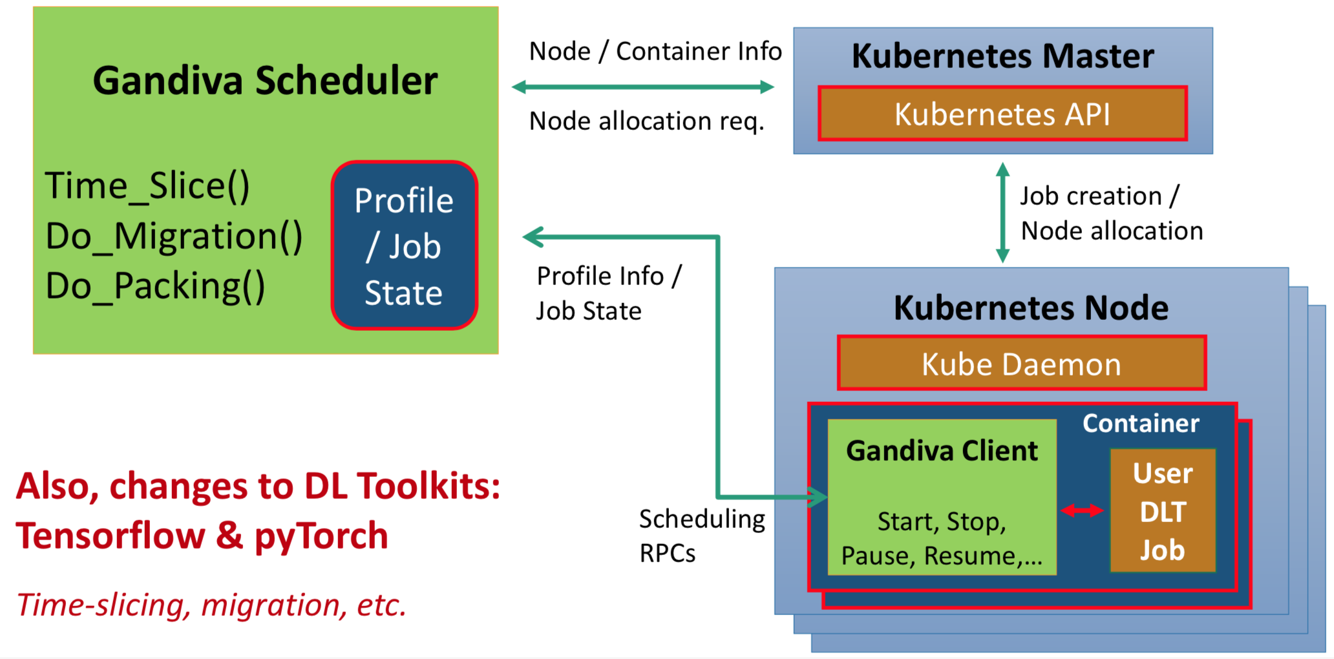
Implementation
Notes:
Consolidation: the minimum number of servers.

Slide 41
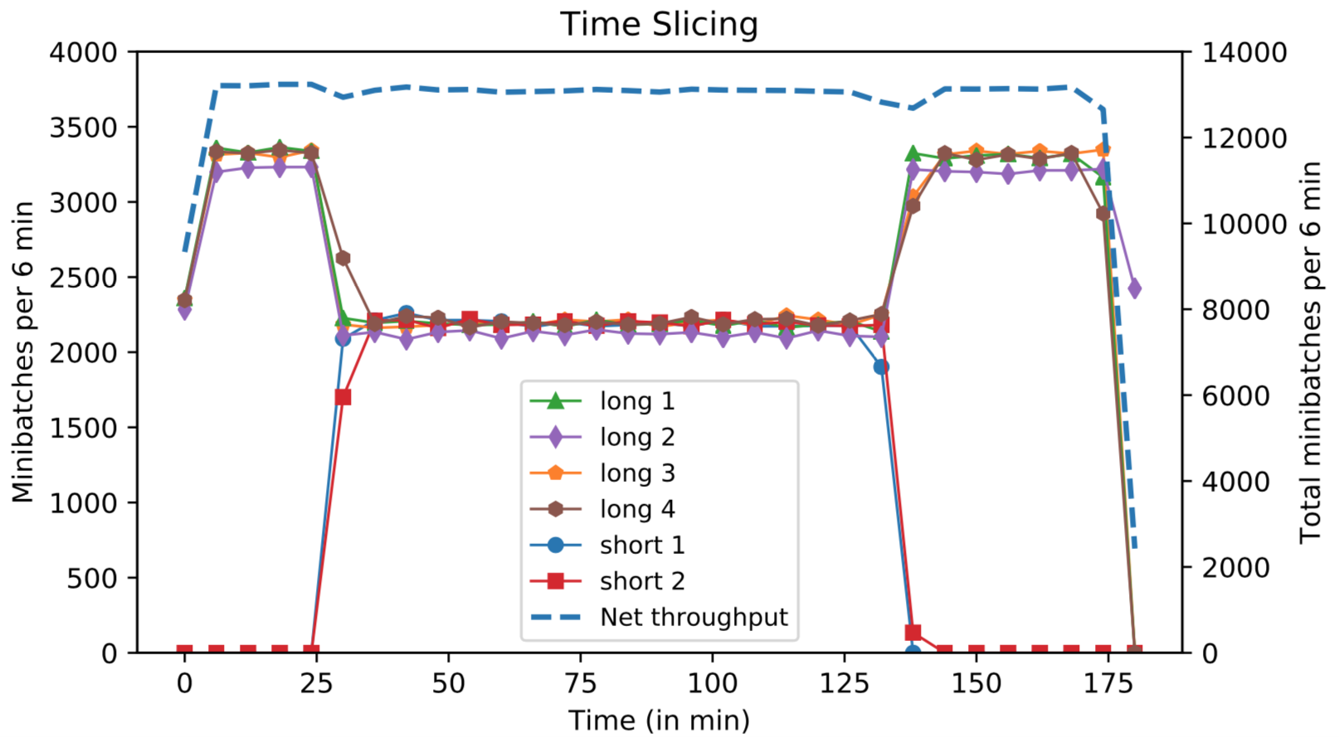
Evaluation
Time-slicing
6 jobs (4 long, 2 short) share 4 GPUs
Low overhead: total throughput remains the same
Notes:
Consolidation: the minimum number of servers.

Slide 42
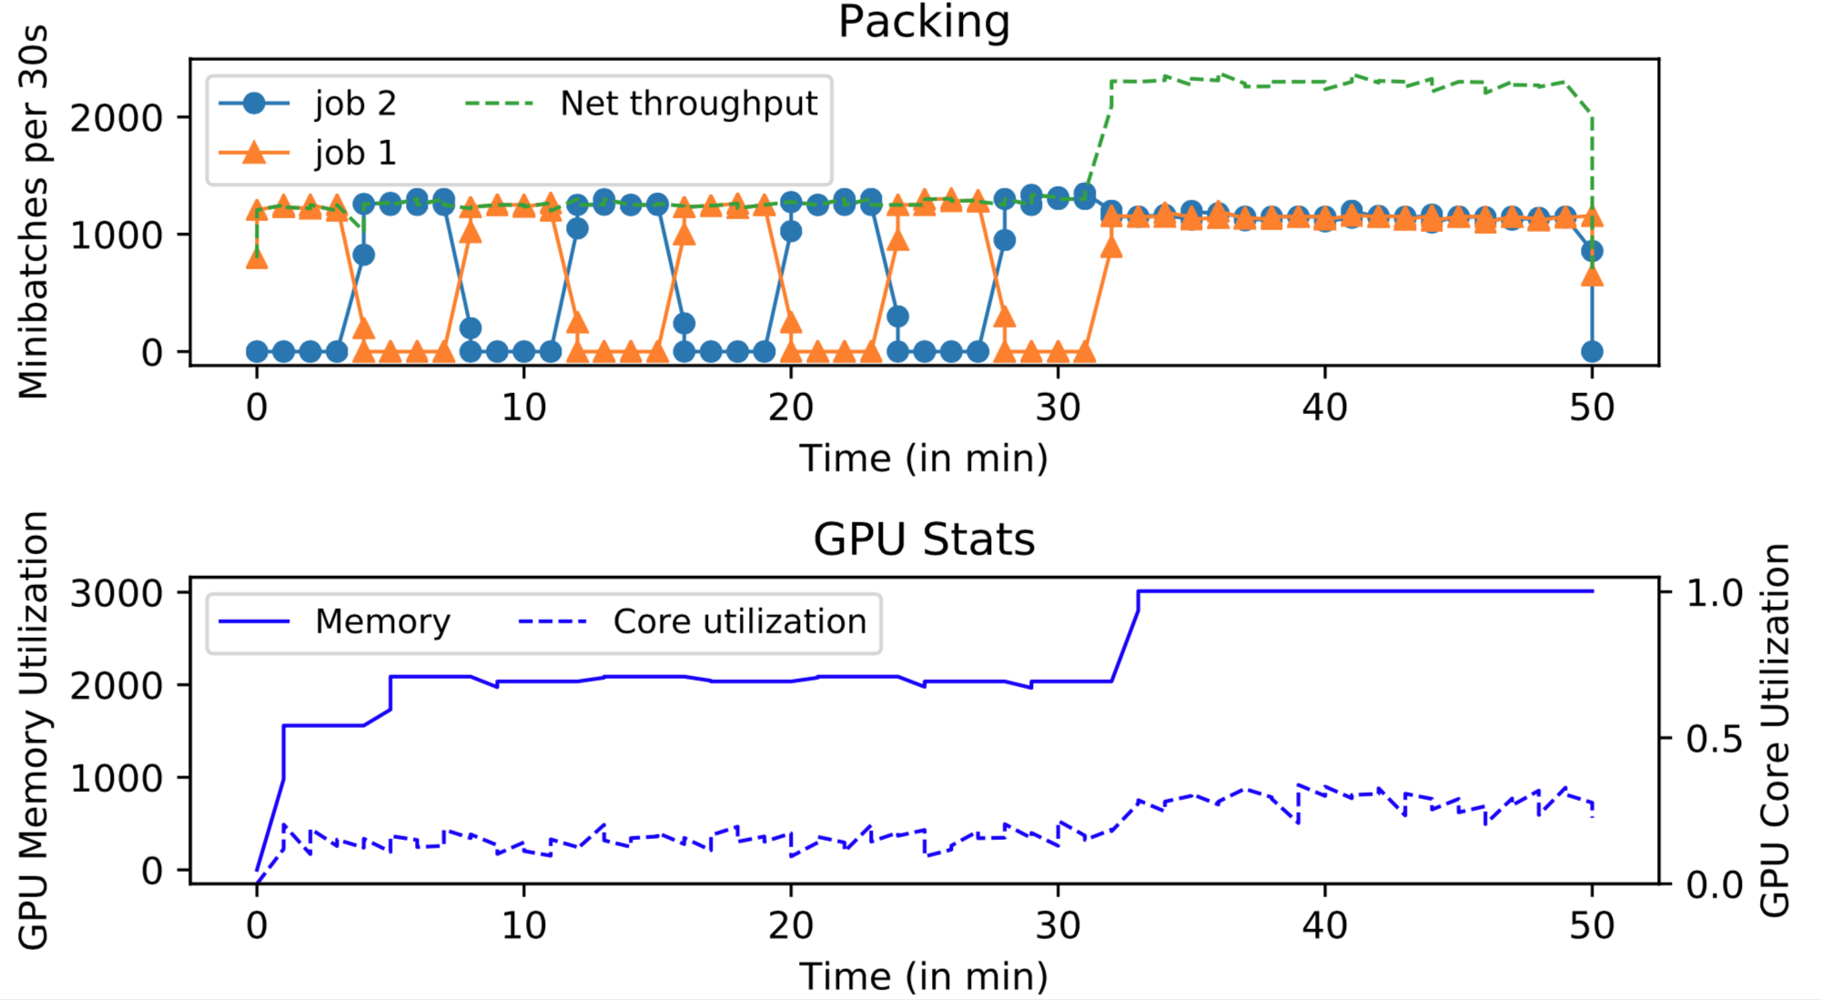
Evaluation
Packing
2 jobs packed on the same GPU
Higher total throughput with packing
Notes:
Consolidation: the minimum number of servers.

Slide 43
Evaluation
Model exploration
AutoML: explore 100 hyper-parameter configurations on 16 GPUs
More configurations can be explored in parallel
Jobs with low quality can be stopped earlier
 | Accuracy: 70% | Accuracy: 80% | Accuracy: 90%
Baseline (HyperOpt) | 134.1 | 2489.1 | 5296.7
Gandiva | 134.1 | 543.1 | 935.4
Speedup | 1x | 5.25x | 5.66x
Time (mins) to find config w/ accuracy > threshold
Notes:
Consolidation: the minimum number of servers.

Slide 44
Gandvia
Introspective GPU cluster scheduling for Deep Learning Training
Efficient time-slicing, packing, migration scheduling primitives
Continuous and introspective scheduling to adapt to the changing environment
Faster & cheaper execution of DLT workflows (hyperparameter tuning)

Slide 45
Q&A
The scheduling scheme in Gandiva to pack jobs on a GPU is by trail and error, and revert if any performance degradation is caused by job interferences.
Will the overhead of this method be too large if the job might be migrated several times?
How to efficiently profiling jobs priorly and predict the interference?
Is greedy heuristic a good solution to pack jobs without considering interference in advance?
How Gandiva schedule jobs during migration in order to migrate interfering jobs and avoid fragmentation harmoniously? Is it possible that migrating interfering jobs will cause any fragmentations and need to further defragmentation?
Notes:
Consolidation: the minimum number of servers.

Slide 46
Q&A
For time-slicing strategy of Gandiva, is it possible that small jobs will interrupt the jobs in cluster most of the time?
Notes:
Consolidation: the minimum number of servers.

Slide 47
Thank You
Notes:
Consolidation: the minimum number of servers.

Slide 48
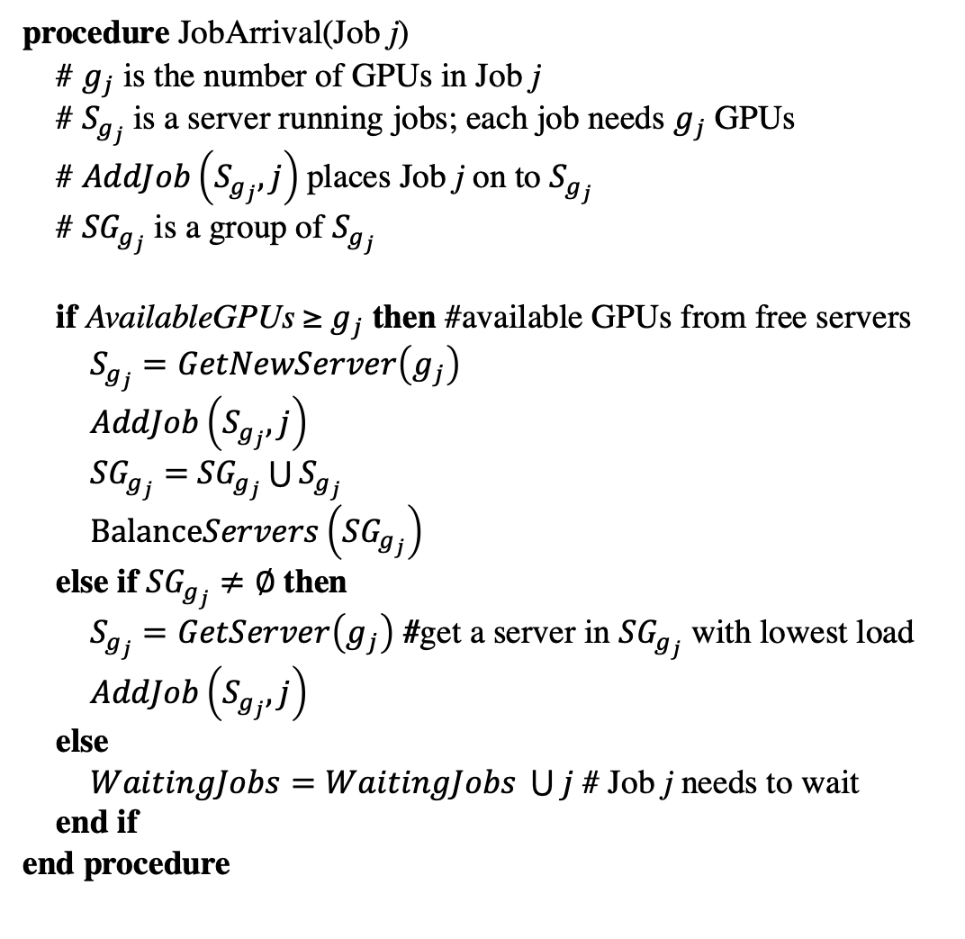
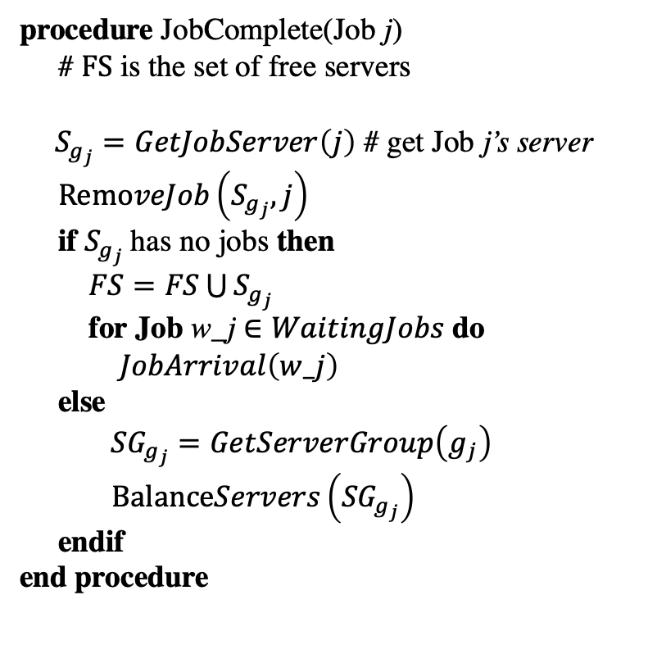
Gandiva Algorithm (I guess…)
procedure JobArrival(Job j)
# $g_{j}$ is the number of GPUs in Job j
# $S_{g_{j}}$ is a server running jobs; each job needs $g_{j}$ GPUs
# $AddJob\left(S_{g_{j}}, j\right)$places Job j on to $S_{g_{j}}$
# ${SG}_{g_{j}}$ is a group of $S_{g_{j}}$
if AvailableGPUs ≥ $g_{j}$ then #available GPUs from free servers
$S_{g_{j}}=GetNewServer\left(g_{j}\right)$
$AddJob\left(S_{g_{j}}, j\right)$
${SG}_{g_{j}}=$ ${SG}_{g_{j}}\bigcup{S_{g_{j}}}$
$BalanceServers\left({SG}_{g_{j}}\right)$
else if ${SG}_{g_{j}}≠∅$ then
$S_{g_{j}}=GetServer\left(g_{j}\right)$ #get a server in ${SG}_{g_{j}}$ with lowest load
$AddJob\left(S_{g_{j}}, j\right)$
else
$WaitingJobs=WaitingJobs \bigcup{j}$ # Job j needs to wait
end if
end procedure
procedure JobComplete(Job j)
# $FS$ is the set of free servers
$S_{g_{j}}=GetJobServer\left(j\right)$ # get Job j’s server
$RemoveJob\left(S_{g_{j}}, j\right)$
if $S_{g_{j}}$has no jobs then
$FS=FS\bigcup{S_{g_{j}}}$
for Job w_j $∈WaitingJobs$ do
$JobArrival\left(w_j\right)$
else
${SG}_{g_{j}}=GetServerGroup\left(g_{j}\right)$
$BalanceServers\left({SG}_{g_{j}}\right)$
endif
end procedure
Notes:
Consolidation: the minimum number of servers.

